Slide 1
Chapters 20, 21
Testing Hypotheses
about Proportions
Part II: Significance Levels, Type I and Type II Errors, Power
1

Slide 2
Alpha Levels: a Threshold for the P-value.
Sometimes we need to make a firm decision about whether or not to reject the null hypothesis.
When the P-value is small, it tells us that our data are rare if the null hypothesis is true.
How rare is “rare”?

Slide 3
Alpha Levels (cont.)
We can define “rare event” arbitrarily by setting a threshold for our P-value.
  If our P-value falls below that threshold, we’ll reject H₀. We call such results statistically significant.
  The threshold is called an alpha level, denoted by α.

Slide 4
Alpha Levels (cont.)
Common alpha levels are 0.10, 0.05, and 0.01.
  You have the option—almost the obligation—to consider your alpha level carefully and choose an appropriate one for the situation.
The alpha level is also called the significance level.
  When we reject the null hypothesis, we say that the test is “significant at that level.”
Rejection Region (RR): values of the test statistic z that lead to rejection of the null hypothesis H₀.

Slide 5
Levels and
Rejection Regions 1-Tail
If H_{A}: p > p₀ and =.10
then RR={z: z > 1.28}
If H_{A}: p > p₀ and =.05 then RR={z: z > 1.645}
 | Rej Region
.10 | Z > 1.28
.05 | Z > 1.645
.01 | Z > 2.33
If H_{A}: p > p₀ and =.01
then RR={z: z > 2.33}
5
Notes:
QTM1310/ Sharpe
5

Slide 6
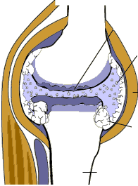
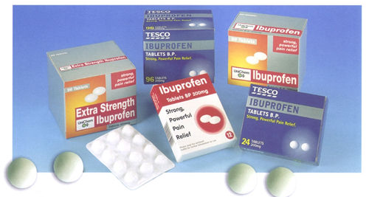
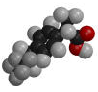
Medication side effects (hypothesis test for p)
Arthritis is a painful, chronic inflammation of the joints.
An experiment on the side effects of the pain reliever ibuprofen examined arthritis patients to find the proportion of patients who suffer side effects. If more than 3% of users suffer side effects, the FDA will put a stronger warning label on packages of ibuprofen
Serious side effects (seek medical attention immediately):
Allergic reaction (difficulty breathing, swelling, or hives),
Muscle cramps, numbness, or tingling,
Ulcers (open sores) in the mouth,
Rapid weight gain (fluid retention),
Seizures,
Black, bloody, or tarry stools,
Blood in your urine or vomit,
Decreased hearing or ringing in the ears,
Jaundice (yellowing of the skin or eyes), or
Abdominal cramping, indigestion, or heartburn,
Less serious side effects (discuss with your doctor):
Dizziness or headache,
Nausea, gaseousness, diarrhea, or constipation,
Depression,
Fatigue or weakness,
Dry mouth, or
Irregular menstrual periods
What are some side effects of ibuprofen?

Slide 7

440 subjects with chronic arthritis were given ibuprofen for pain relief; 23 subjects suffered from adverse side effects.
H₀ : p =.03 H_{A} : p > .03 where p is the proportion of
Ibuprofen users who suffer side effects. Let  = .05
Rejection Region: z > 1.645
Test statistic:
Conclusion: since the test statistic value 2.75 is in the RR, reject H₀ : p =.03;
there is sufficient evidence to conclude that the proportion of ibuprofen users who suffer side effects is greater than .03
P-value=
P(z>2.75) = . 003

Slide 8
Levels and
Rejection Regions 1-Tail
If H_{A}: p < p₀ and =.10
then RR={z: z < -1.28}
If H_{A}: p < p₀ and =.05 then RR={z: z < -1.645}
 | Rej Region
.10 | Z < -1.28
.05 | Z < -1.645
.01 | Z < -2.33
If H_{A}: p < p₀ and =.01
then RR={z: z < -2.33}
8
Notes:
QTM1310/ Sharpe
8

Slide 9
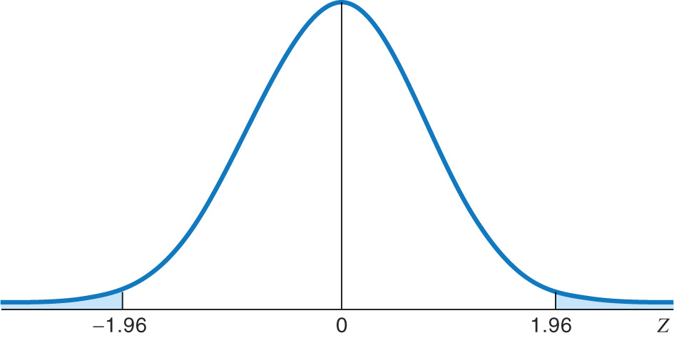
Rejection region for a 2-tail test of p with α = 0.05
A 2-tailed test means that area α/2 is in each tail, thus:
-A middle area of 1 − α = .95, and tail areas of α /2 = 0.025.
RR={z < -1.96, z > 1.96}
0.025
0.025
From Z Table

Slide 10
Levels and Rejection Regions 2-Tail
If H_{A}: p  p₀ and =.10, then
RR={z: z < -1.645, z>1.645}
If H_{A}: p  p₀ and =.05, then RR={z: z < -1.96, z > 1.96}
 | Rejection Region
.10 | Z < -1.645, Z > 1.645
.05 | Z < -1.96, Z > 1.96
.01 | Z < -2.58, Z > 2.58
If H_{A}: p  p₀ and =.01, then
RR={z: z < -2.58, z > 2.58}
10
Notes:
QTM1310/ Sharpe
10

Slide 11
Example: one-proportion z test
A marketing company claims that it receives 8% responses from its mailing. To test this claim, a random sample of 500 were surveyed with 25 responses. Perform a 2-sided hypothesis test to evaluate the company’s claim. Use  = .05
Check:
n p = (500)(.08) = 40
n(1-p) = (500)(.92) = 460


Slide 12
Solution
H₀: p = .08 H_{A}: p ≠ .08
 = .05
Test Statistic:
Conclusion: since the test statistic value
z = -2.47 is in the rejection region, we reject the company’s claim of 8% response rate.
.0068
.0068
z
-2.47
0
2.47

Slide 13
 Levels and Rejection Regions
H_{A}: p > p₀ H_{A}: p < p₀
H_{A}: p ≠ p₀
 | Rejection Region
.01 | Z > 2.33
.05 | Z > 1.645
.10 | Z > 1.28
 | Rejection Region
.01 | Z < -2.33
.05 | Z < -1.645
.10 | Z < -1.28
 | Rejection Region
.01 | Z < -2.58, Z > 2.58
.02 | Z < -2.33, Z > 2.33
.05 | Z < -1.96, Z > 1.96
.10 | Z < -1.645, Z > 1.645

Slide 14
Alpha Levels (cont.)
What can you say if the P-value does not fall below α?
  You should say that “The data have failed to provide sufficient evidence to reject the null hypothesis.”
  Don’t say that you “accept the null hypothesis.”

Slide 15
Alpha Levels (cont.)
Recall that, in a jury trial, if we do not find the defendant guilty, we say the defendant is “not guilty”—we don’t say that the defendant is “innocent.”

Slide 16
Alpha Levels (cont.)
The P-value gives the reader far more information than just stating that you reject or fail to reject the null.
In fact, by providing a P-value to the reader, you allow that person to make his or her own decisions about the test.
  What you consider to be statistically significant might not be the same as what someone else considers statistically significant.
  There is more than one alpha level that can be used, but each test will give only one P-value.

Slide 17
Confidence Intervals and Hypothesis Tests
Because confidence intervals are two-sided, they correspond to two-sided (two-tailed) hypothesis tests.
In general, a confidence interval with a confidence level of C% corresponds to a two-sided hypothesis test with an α-level of 100 – C%. For example:
  If a 2-sided hypothesis test at level .05 rejects H₀ , then the null hypothesized value of p will not be in a 95% confidence interval calculated from the same data.
  A 95% confidence interval shows the values of null hypothesis values p for which a 2-sided hypothesis test at level .05 will NOT reject the null hypothesis.

Slide 18
Confidence Intervals and Hypothesis Tests: Example
A marketing company claims that it receives 8% responses from its mailing. To test this claim, a random sample of 500 were surveyed with 25 responses. Calculate a 95% confidence interval to estimate the company’s response rate.
Check:
n p = (500)(.08) = 40
n(1-p) = (500)(.92) = 460


Slide 19
Solution
Recall that we rejected H₀: p=.08 for the hypothesis test H₀: p = .08 H_{A}: p ≠ .08 with  = .05
The 95% confidence interval (.031, .069) gives the values of p₀ for which a 2-tailed hypothesis test
H₀: p = p₀ , H_{A}: p ≠ p₀ at  =.05 will NOT reject H₀: p = p₀

Slide 20
Making Errors
Here’s some shocking news for you: nobody’s perfect. Even with lots of evidence we can still make the wrong decision.
When we perform a hypothesis test, we can make mistakes in two ways:
  The null hypothesis is true, but we mistakenly reject it. (Type I error)
  The null hypothesis is false, but we fail to reject it. (Type II error)

Slide 21
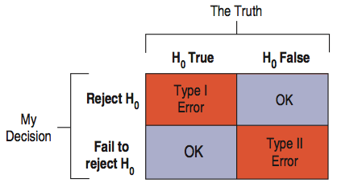
Making Errors (cont.)
Which type of error is more serious depends on the situation at hand. In other words, the gravity of the error is context dependent.
Here’s an illustration of the four situations in a hypothesis test:

Slide 22
Making Errors (cont.)
How often will a Type I error occur?
  Since a Type I error is rejecting a true null hypothesis, the probability of a Type I error is our α level.
When H₀ is false and we reject it, we have done the right thing.
  A test’s ability to detect a false hypothesis is called the power of the test.

Slide 23
Making Errors (cont.)
When H₀ is false and we fail to reject it, we have made a Type II error.
  We assign the letter β to the probability of this mistake.
  It’s harder to assess the value of β because we don’t know what the value of the parameter really is.
  There is no single value for β--we can think of a whole collection of β’s, one for each incorrect parameter value.

Slide 24
Making Errors (cont.)
One way to focus our attention on a particular β is to think about the effect size.
  Ask “How big a difference would matter?”
We could reduce β for all alternative parameter values by increasing α.
  This would reduce β but increase the chance of a Type I error.
  This tension between Type I and Type II errors is inevitable.
The only way to reduce both types of errors is to collect more data. Otherwise, we just wind up trading off one kind of error against the other.

Slide 25
Example
The proportion of NCSU undergraduates with student loans historically has been approximately 35%. The director of financial aid thinks this percentage has increased recently because of tuition increases. A random sample of 225 students results in 81 that have student loans.
Perform a hypothesis test to determine if the percentage of NCSU undergraduates with student loans has increased. Use =.05

Slide 26
Solution
Conclusion: since the value of the test statistic is not in the rejection region, we DO NOT reject
H₀: p=.35. There is insufficient evidence to conclude that the proportion of NCSU undergrads with student loans has increased.
What type of error might we be making?
Type II
What is the probability we are making a type I error?
0

Slide 27
Solution (cont.)
What is the probability of a type II error when the true value of p is .37?

Slide 28
Power
The power of a test is the probability that it correctly rejects a false null hypothesis.
When the power is high, we can be confident that we’ve looked hard enough at the situation.
The power of a test is 1 – β ; because β is the probability that a test fails to reject a false null hypothesis and power is the probability that it does reject.

Slide 29
Power (cont.)
Whenever a study fails to reject its null hypothesis, the test’s power comes into question.
When we calculate power, we imagine that the null hypothesis is false.
The value of the power depends on how far the truth lies from the null hypothesis value.
  The distance between the null hypothesis value, p₀, and the truth, p, is called the effect size.
  Power depends directly on effect size.

Slide 30
A Picture Worth Words
The larger the effect size, the easier it should be to see it.
Obtaining a larger sample size decreases the probability of a Type II error, so it increases the power.
It also makes sense that the more we’re willing to accept a Type I error, the less likely we will be to make a Type II error.

Slide 31
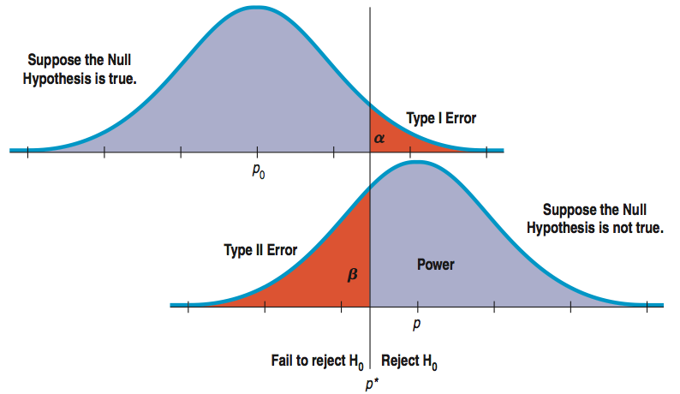
A Picture is Worth Words (cont.)
This diagram shows the relationship between these concepts:

Slide 32
Reducing Both Type I and Type II Error
The previous figure seems to show that if we reduce Type I error, we must automatically increase Type II error.
But, we can reduce both types of error by making both curves narrower.
How do we make the curves narrower? Increase the sample size.

Slide 33
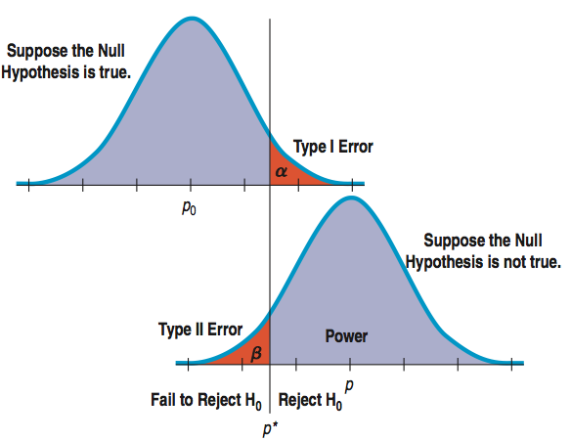
Reducing Both Type I and Type II Error (cont.)
This figure has means that are just as far apart as in the previous figure, but the sample sizes are larger, the standard deviations are smaller, and the error rates are reduced:

Slide 34
Reducing Both Type I and Type II Error (cont.)
Original comparison of errors:
Comparison of errors with a larger sample size:

Slide 35
Sample size n for which -level test also satisfies (p₁)=
1-tailed test:
2-tailed test (an approximate solution):
where

